Slide 1


Parametric and Nonparametric Testing of Pitching Statistics
Phil Hughes, New York Yankees
David Price, Tampa Bay Rays
By: Tyler Dierke

Slide 2
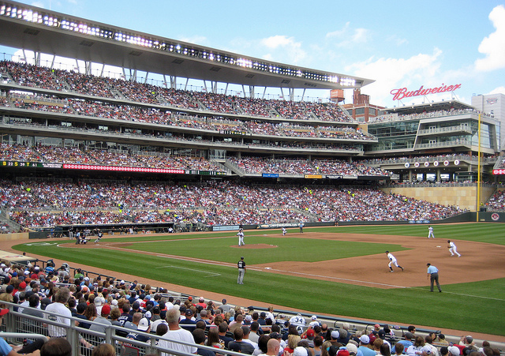
The Goals
Four statistics: SO/BF, BB/BF, ER/BF, and H/BF
Three sets of tests:
  Difference between National league (NL) and American League (AL) pitchers for these statistics
  Difference between young (<28 years old) and old (≥28 years old) for these statistics
  Association between some of the statistics (particularly, SO/BF vs. ER/BF and SO/BF vs. BB/BF)

Slide 3
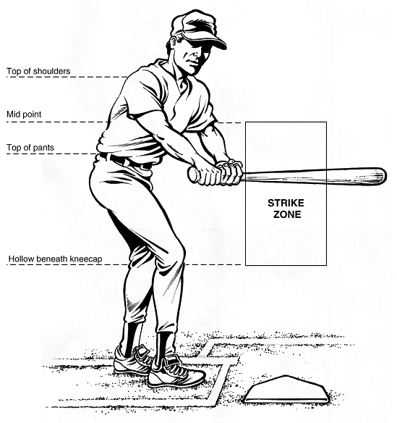
The Tests (Parametric vs. Nonparametric)
2 sample t-test vs. Mann-Whitney Wilcoxon, for both league and age differences
Pearson’s r vs. Spearman’s ρ, both tests of association

Slide 4
Between Leagues
Nonparametric Tests (Mann-Whitney Wilcoxon)
H₀: θ_{AL}= θ_{NL} versus H₁ : θ_{AL}≠ θ_{NL}
SO/BF: p-value=0.07374
BB/BF: p-value=0.9367
ER/BF: p-value=0.8606
H/BF: p-value=0.8587
Parametric Tests (2 Sample t-test)
H₀: μ_{AL}= μ_{NL} versus H₁ : μ_{AL}≠ μ_{NL}
SO/BF: p-value=0.03594*
BB/BF: p-value=0.9202
ER/BF: p-value=0.98
H/BF: p-value=0.7228
*indicates a significant difference between the National League and American League (at significance level α=0.05)

Slide 5
Between Age Groups
Nonparametric Tests (Mann-Whitney Wilcoxon)
H₀: θ_{<28}= θ _{≥28} versus H₁ : θ_{<28}≠ θ _{≥28}
SO/BF: p-value=0.03487*
BB/BF: p-value=0.00022*
ER/BF: p-value=0.4523
H/BF: p-value=0.3354
Parametric Tests (2 Sample t-test)
H₀: μ_{<28}= μ_{≥28} versus H₁ : μ_{<28}≠ μ _{≥28}
SO/BF: p-value=0.006339*
BB/BF: p-value=0.01678*
ER/BF: p-value=0.9442
H/BF: p-value=0.5622
*indicates a significant difference between younger and older age groups (at significance level α=0.05)

Slide 6
Association Tests
Between SO/BF and ER/BF:
Parametric Tests (Pearson’s r)
H₀: r= 0 versus H₁: r≠0
p-value<2.2e-16*
Nonparametric Tests (Spearman’s ρ)
H₀: ρ = 0 versus H₁: ρ ≠0
p-value<2.2e-16*
*indicates a significant correlation between SO/BF and ER/BF
(at significance level α=0.05)

Slide 7
Association Tests
Between SO/BF and BB/BF:
Parametric Tests (Pearson’s r)
H₀: r= 0 versus H₁: r≠0
p-value=0.0003553
Nonparametric Tests (Spearman’s ρ)
H₀: ρ = 0 versus H₁: ρ ≠0
p-value=0.8925
*indicates a significant correlation between SO/BF and BB/BF
(at significance level α=0.05)

Slide 8


Tim Lincecum, San Francisco Giants

